Slide 1
BANKING APPLICATION
SUBMITTED BY:
SHIVANI JAIN
SHUBHAM GULYANI
SHWETA SOAM

Slide 2
MODULES INCLUDED:
LOGIN
CHECK DATABASE AND PERFORM OTHER FUNCTIONS
SEARCHING(by name or by account number)
TRANSACTION(credit or debit)
ADD ACCOUNT
DELETE ACCOUNT
LOAN
SEND MAIL
SORTING
LOG OUT

Slide 3
THIS IS THE LOGIN PAGE

Slide 4
Valid manager id and password will redirect us to this page where manager is shown with two options.

Slide 5
We can check our database through the link CHECK DATABASE.
We can perform other functions through the link OTHER FUNCTIONS.

Slide 6
on clicking CHECK DATABASE the manager is shown with the database

Slide 7
on clicking OTHER OPTIONS we are shown various options

Slide 8
we have two options for searching either by name or by account

Slide 9
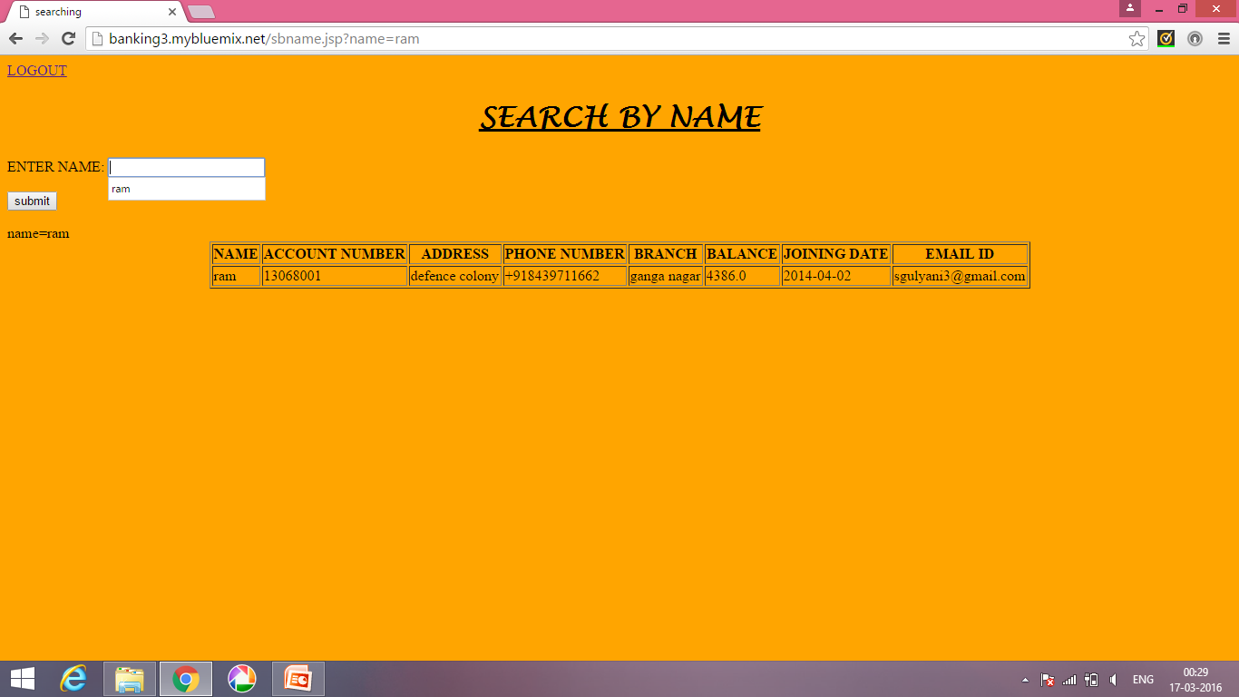
Search BY NAME helps manager to check the details by submitting the customer’s name

Slide 10
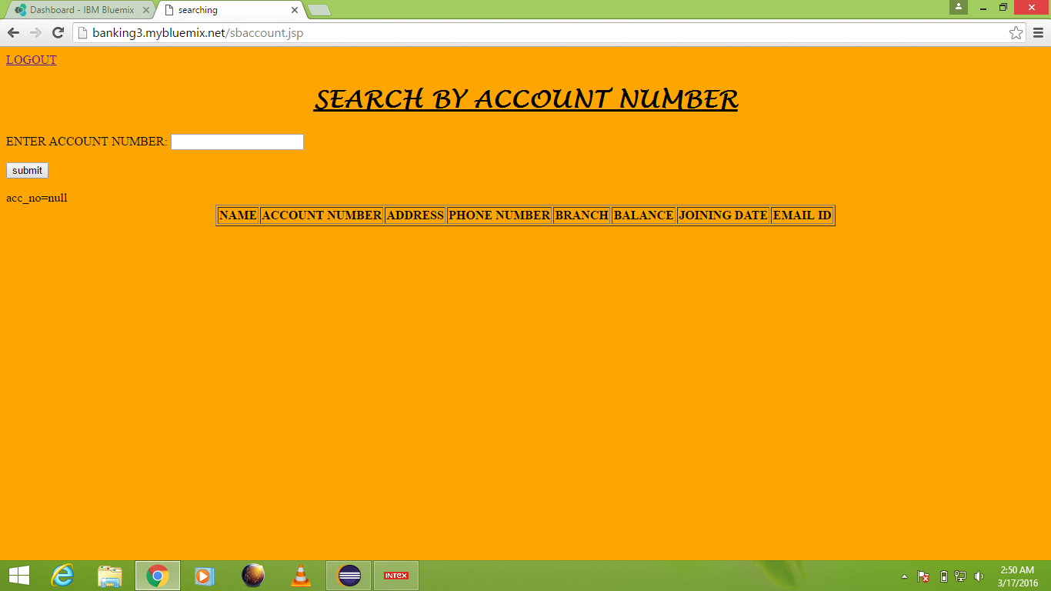
Search BY ACCOUNT NUMBER helps manager to check the details by submitting the customer’s account number

Slide 12
We have two options of transaction namely Credit and Debit

Slide 13
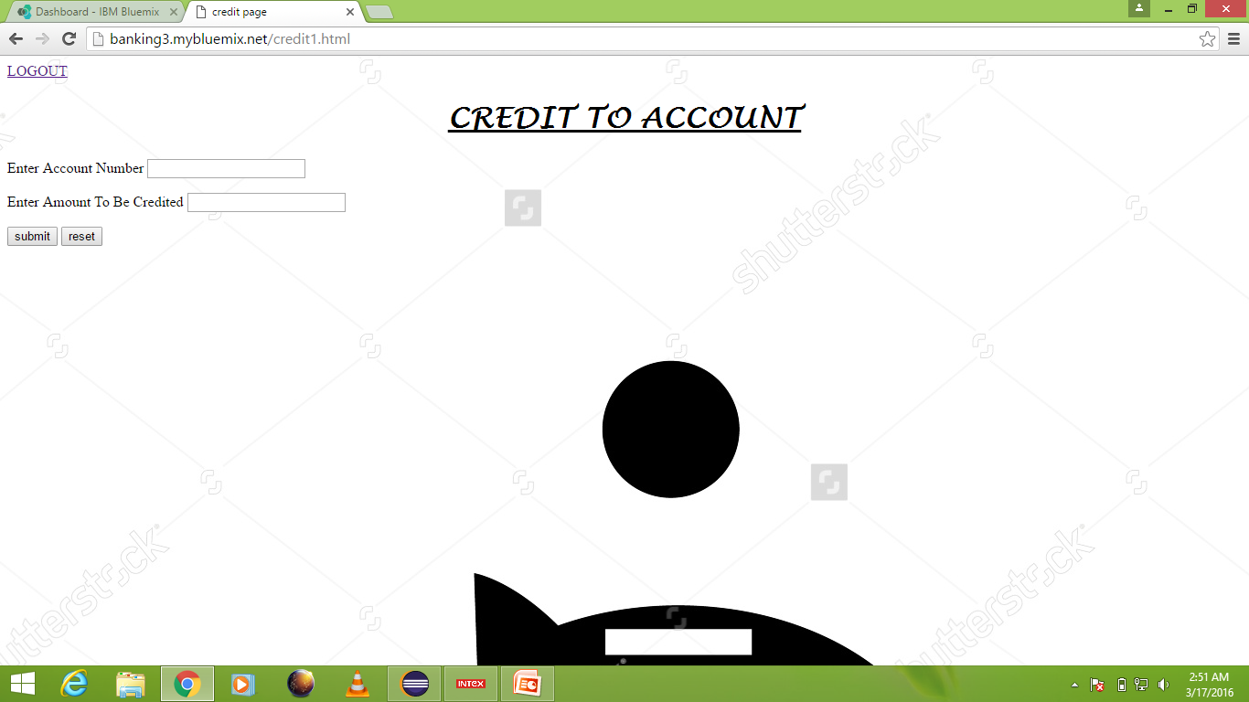
On selecting CREDIT options manager is able to credit to a persons account

Slide 14
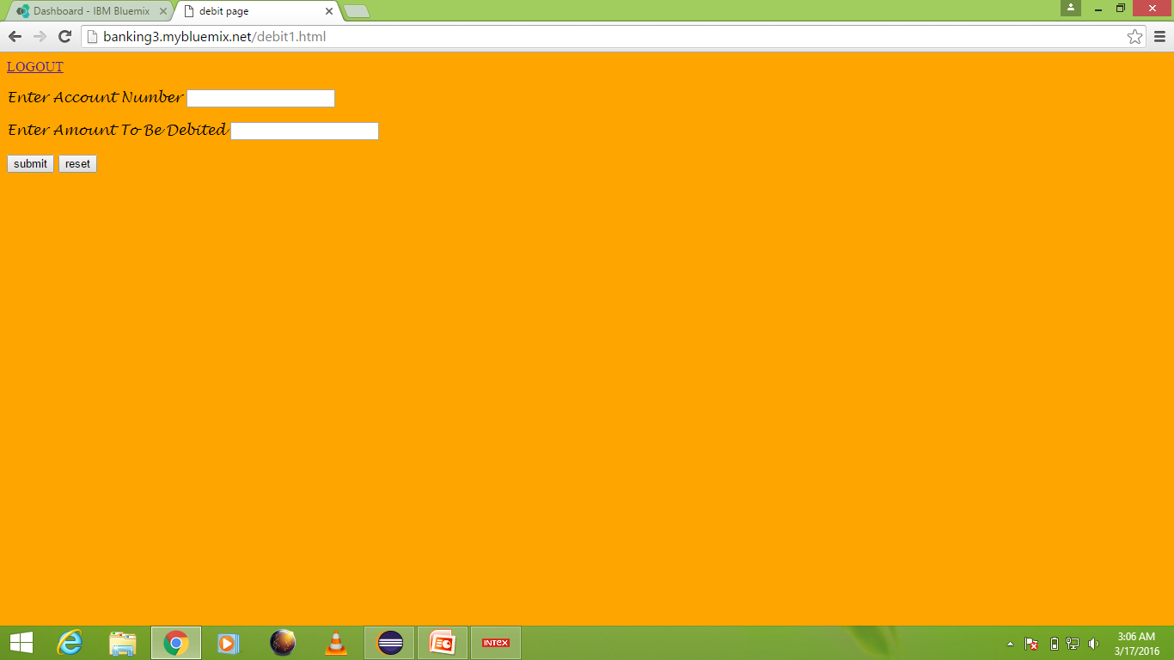
On selecting DEBIT option amounts gets deducted from customer’s account

Slide 15
By clicking ADD ACCOUNT button a form displays. We can add new account by submitting the form.

Slide 16
We can delete any account by entering the account number and submit it.

Slide 17
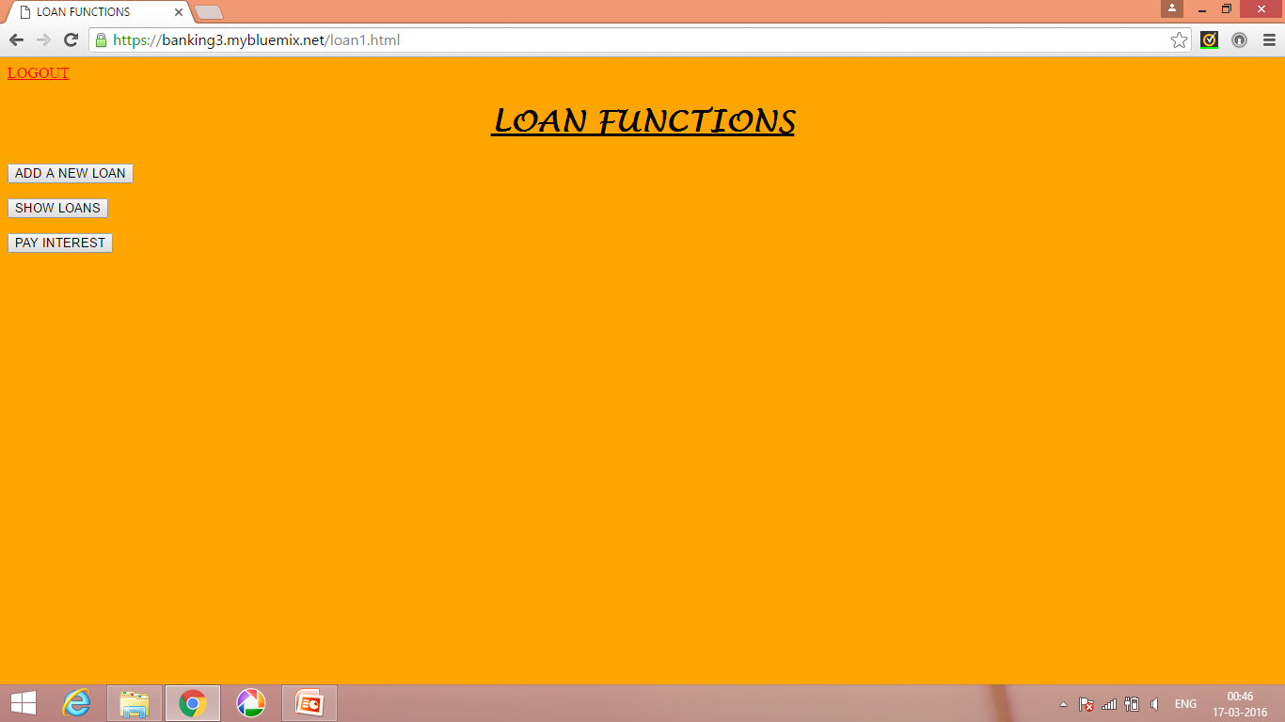
The LOAN button redirects to the page

Slide 18
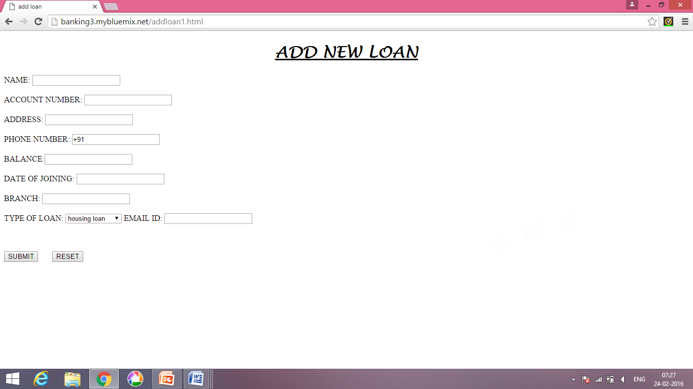
New loan can be provided to customer by clicking on the ADD NEW LOAN button

Slide 19
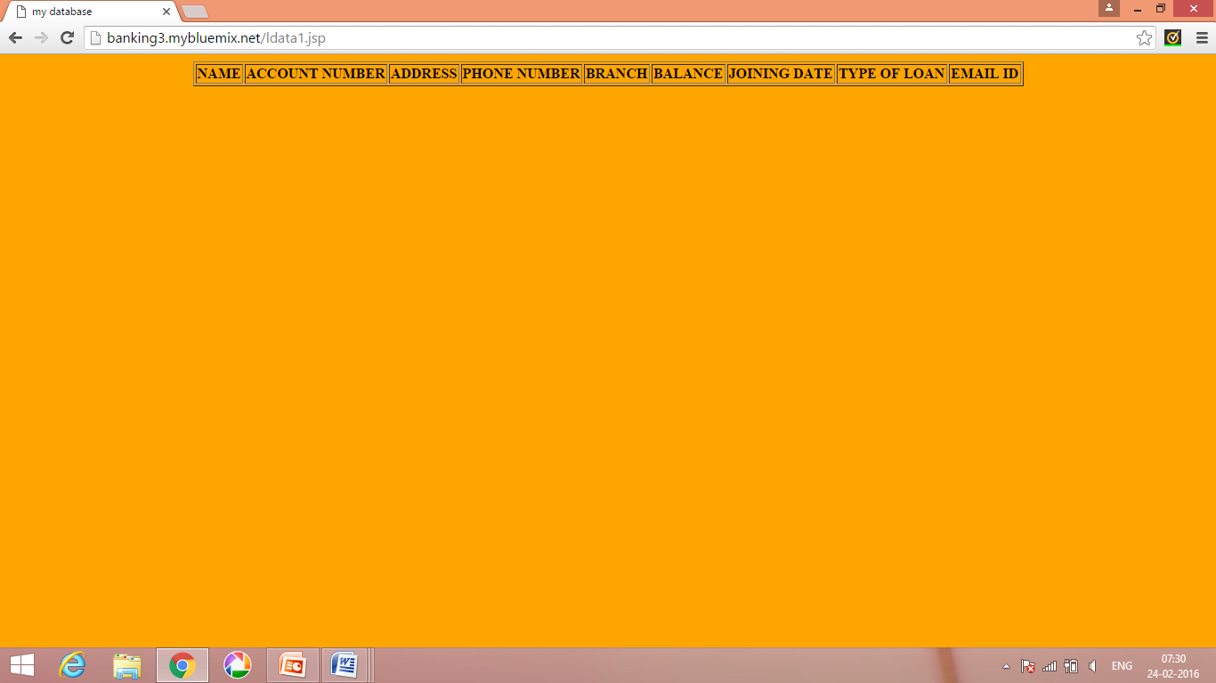
The SHOW LOAN button displays the list of loan holders

Slide 20
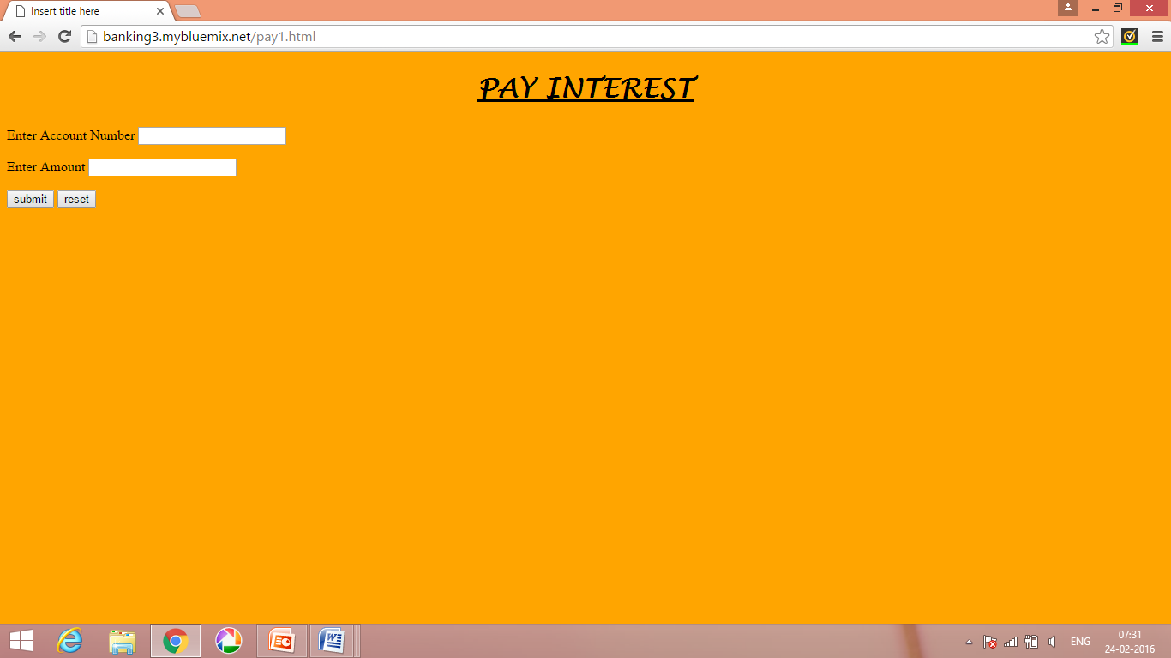
The PAY INTEREST button deducts the amount calculated from the interest paid by the customer from his loan amount.

Slide 21
NOTIFICATIONS:
We have added two services to notify the customer if any changes have been made to his account, either in loan account or in his savings account.
The services for notification used are: by E-MAIL and by SMS.

Slide 22
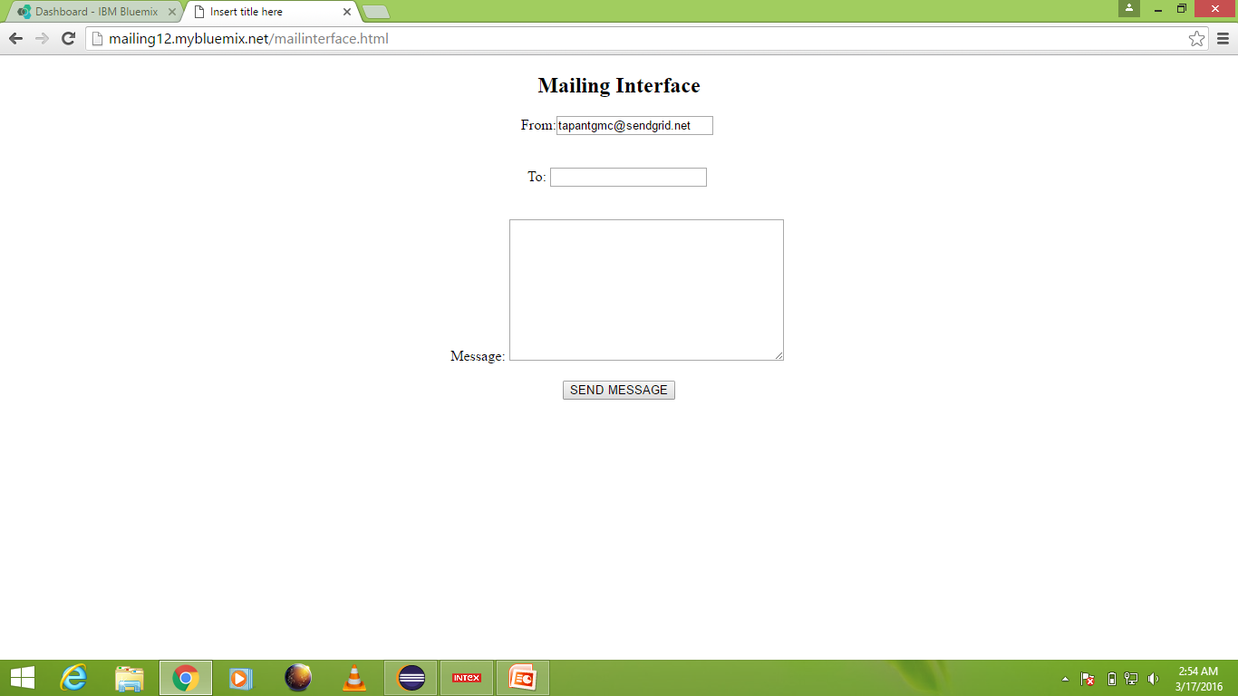
SENDGRID FOR E-MAILING

Slide 23
TWILLIO FOR SMS
This service is used is used in an automatic manner i.e. message to the customer is send when he either credits or debits from his account. Message contains the amount present in the customer’s account after performing the transaction.

Slide 24
The sorting option sorts the database by date of joining

Slide 25
LOGOUT
We have added the logout button at the TOP LEFT corner of each page.
The LOGOUT button redirects us to the login page.

